Slide 1
Infographic Style
Meeting of project partners
28 April, 2021
Planning International TED-type students‘ conference “ECOwe“
Germany
Lithuania
Portugal
Romania
Spain
Turkey
Lithuania
Portugal
Turkey

Slide 2
International TED-type students‘ conference “ECOwe“
28 April, 2021

Slide 3
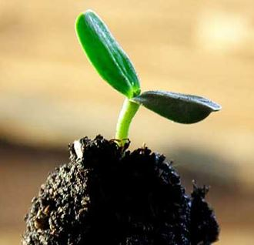

Slide 4
SECTIONS
CIRCULAR ECONOMY
ZERO WASTE
CLIMATE CHANGE
EARTH POLLUTION
WATER POLLUTION
AIR POLLUTION
SUSTAINABILITY
Sub-SECTIONS
Plastic pollution
Biodegradable plastics
Microplastics
Recycling
Reusing
Food wasting
…………

Slide 5
SOME TIPS...
27-28 APRIL, 12:00
2 STUDENTS PER COUNTRY
5 MIN PRESENTATION + QUESTIONS
PRESENTATION TYPE: PPT, INFOGRAPHICS, POSTERS...
EXPERTS (SCIENTISTS / BUSINESS REPRESENTATIVES / ETC.) TO MAKE COMMENTS ON PRESENTATIONS AND GIVE FEEDBACK
STUDENTS CHOOSE THE SECTIONS AND THE TOPIC IN 1-2 WEEKS (UNTIL MARCH 28)
SEND THE STUDENTS AND THEIR TOPICS TO ERNESTA BY THE END OF MARCH (THE SOONER THE BETTER)

