Slide 1


ERASMUS+ KA229
Creation and Integration of STEAM Model
In General Education

Slide 2


Erasmus+ KA229
Stratejik okul ortaklığı
98.290 Euro hibe
Kasım 2019-2021→ Haziran 2022
TÜRKİYE Gaziantep Kolej Vakfı Özel Fen Lisesi
PORTEKİZ Escola Secundária Campos de Melo.
LİTVANYA Vilnius Gedimino technikos universiteto inzinerijos licejus

Slide 3
Presentation of Project for Community
Meetings of students&teachers involved in project activities.
Formation of working groups, discussion about activities, allocation of works, responsibilities
Logo creation
Creation of Project corner at school
Project dissemination in eTwinning platform
Dissemination of Project in website and press-
Country's experts of circular economy. Meetings with scientists, economists, environmentalists, business representatives, etc.
Analysis of country's and EU documents and resolutions of circular economy application
Creation of the object that could be used many times (bags, straws, coffee cups, water bottles, etc.)
An exhibition (at school, also digital international exhibition).
Excursions: landfill sites, hydroelectric power stations etc.

Slide 4


Logo contest

Slide 5
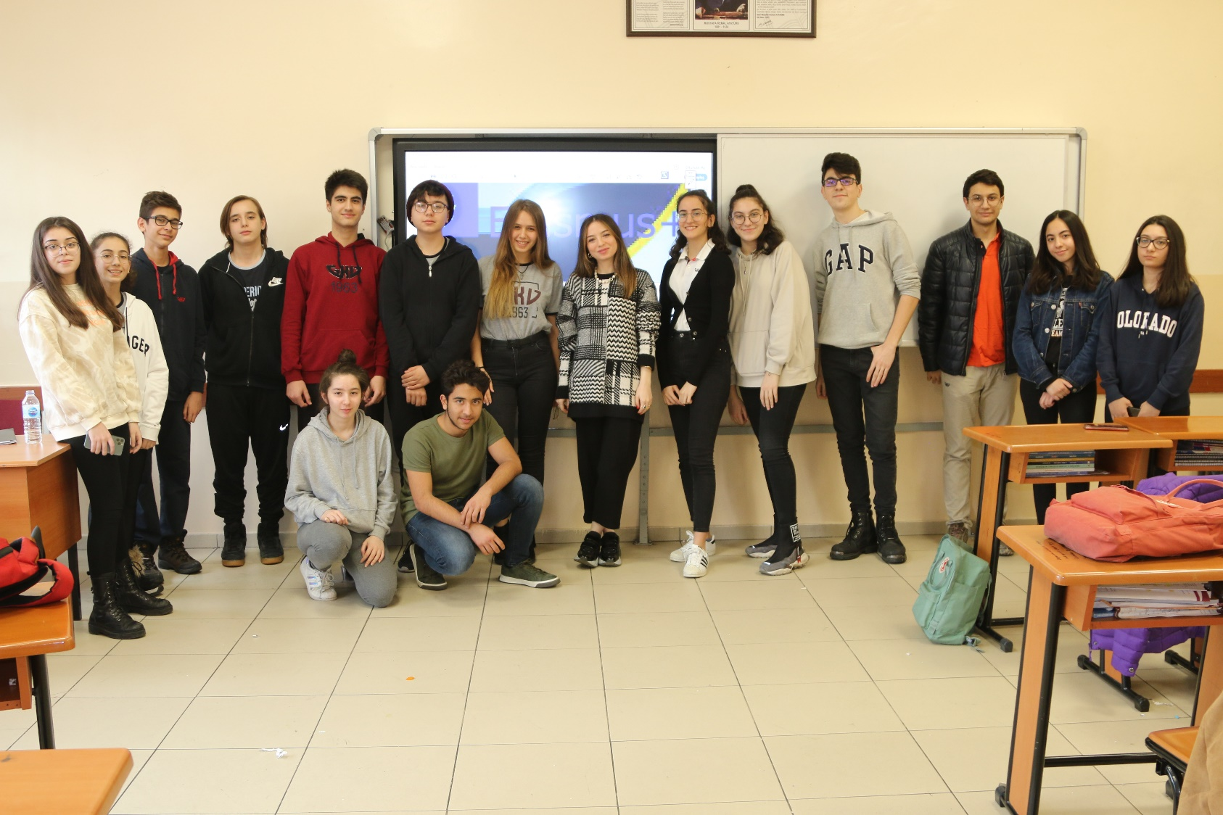
Erasmus+ club

Slide 6
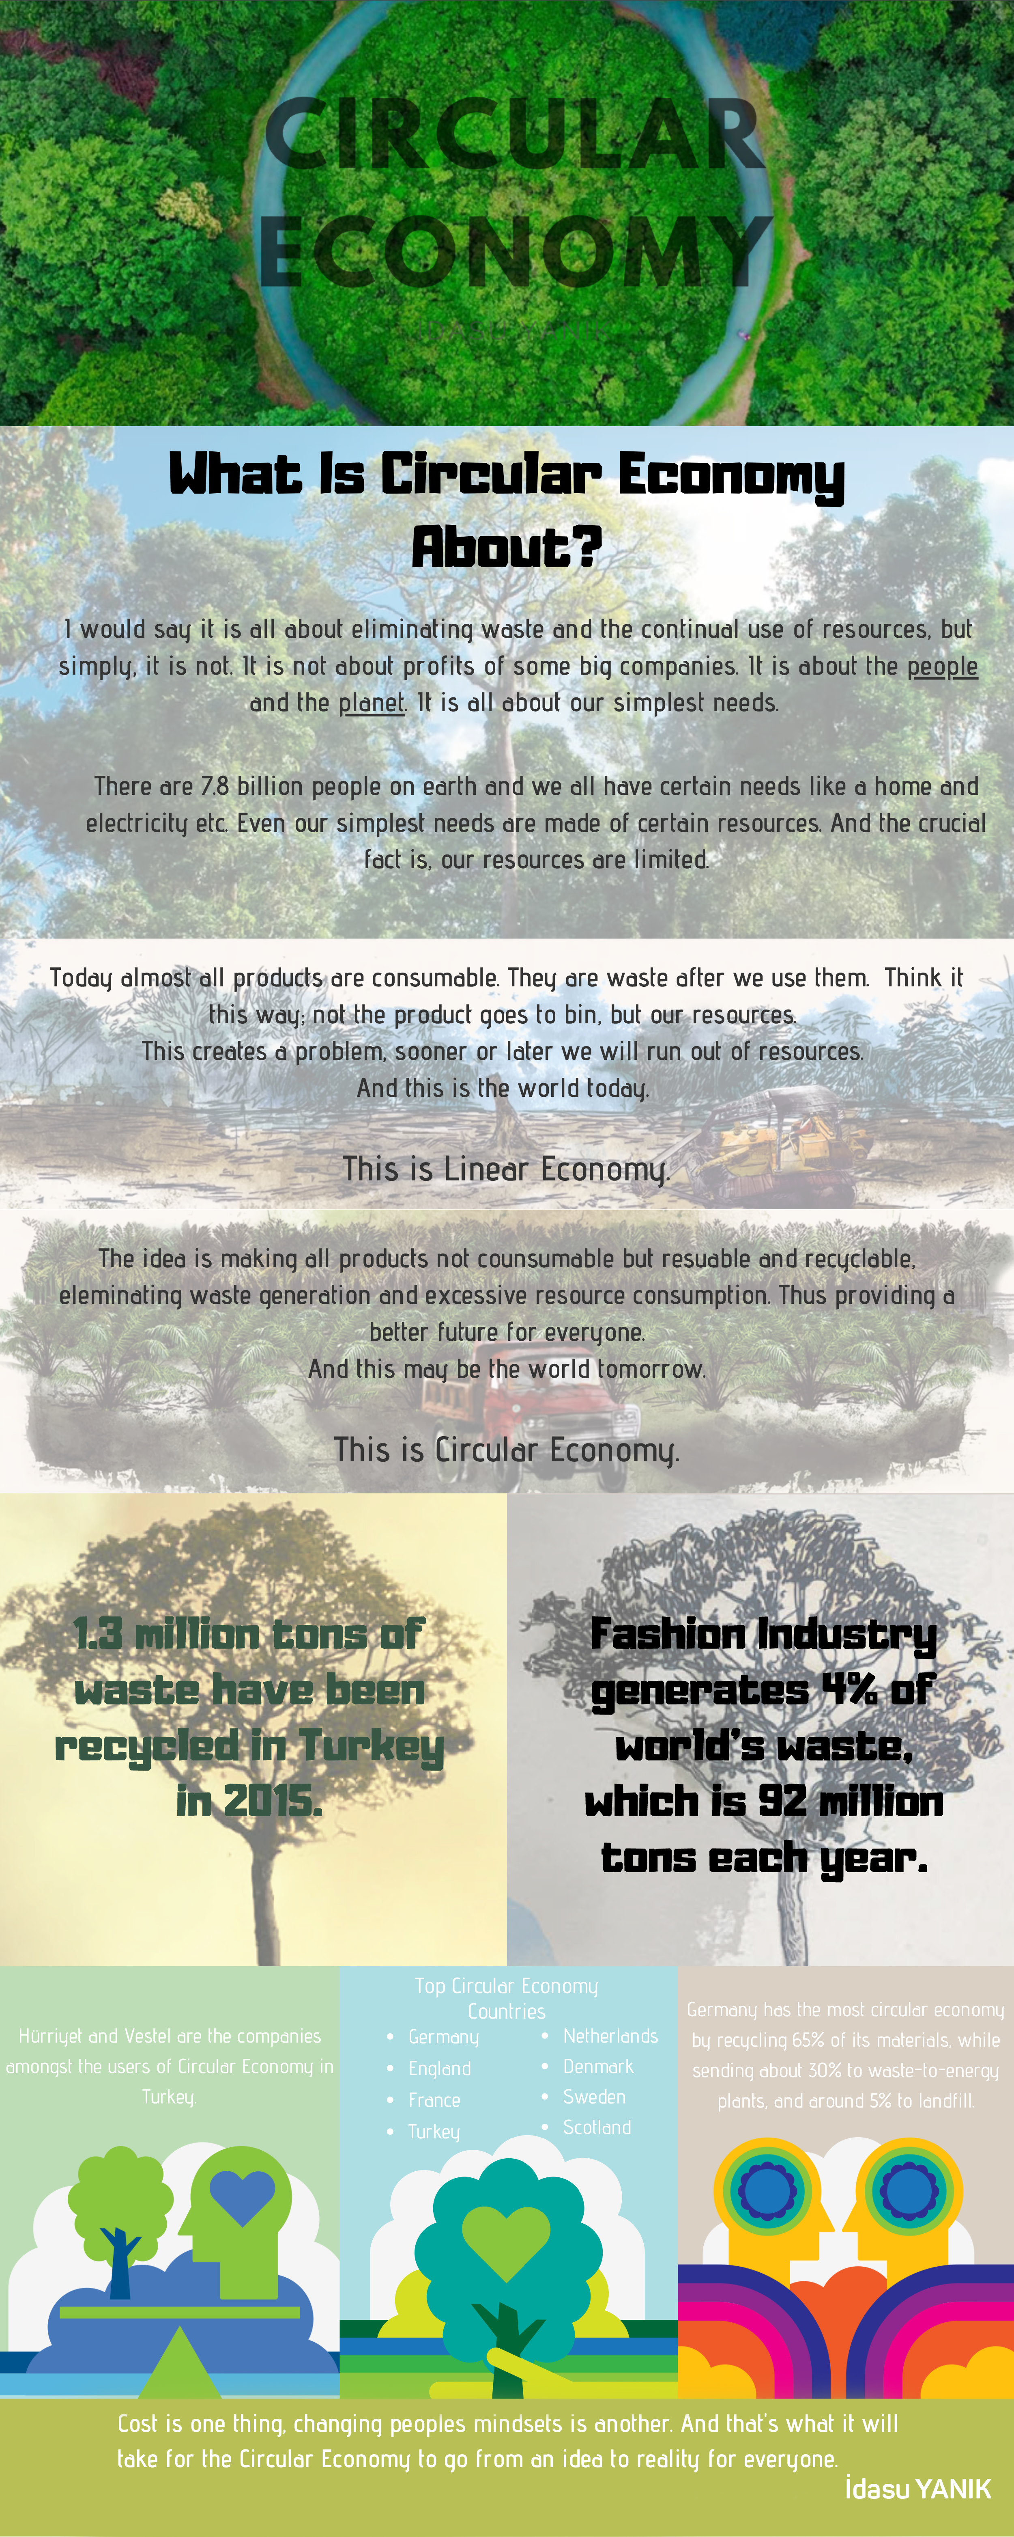
Infographics …

Slide 7
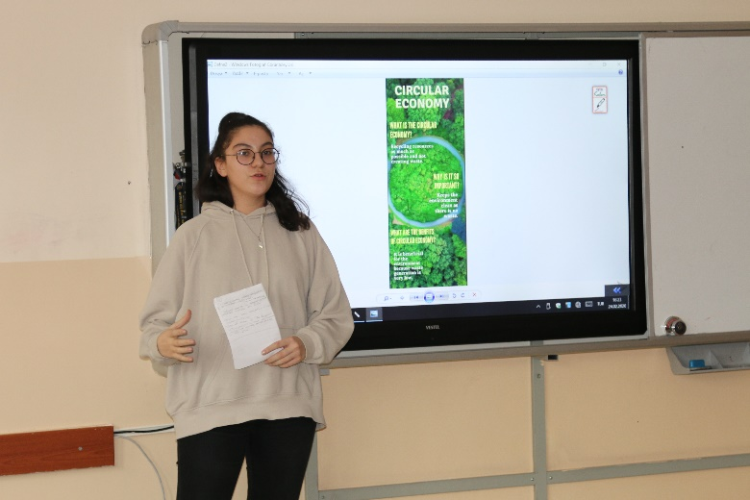
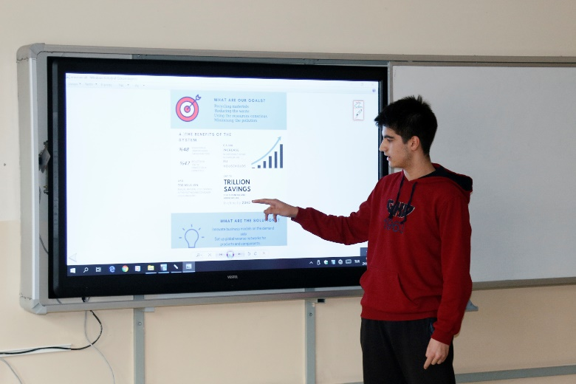
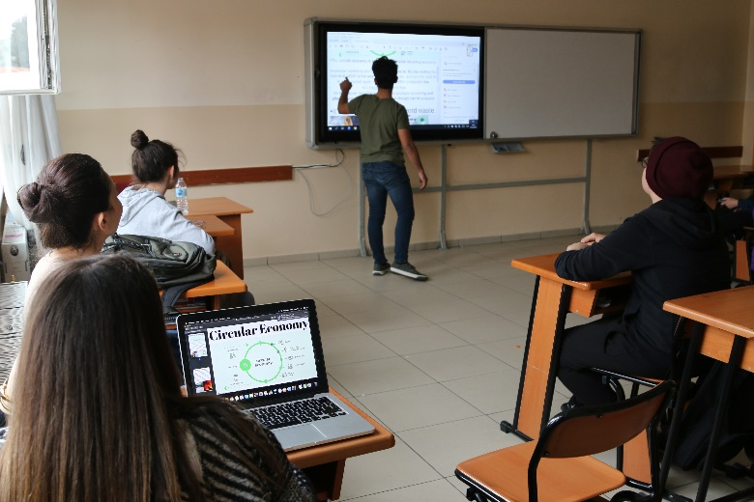
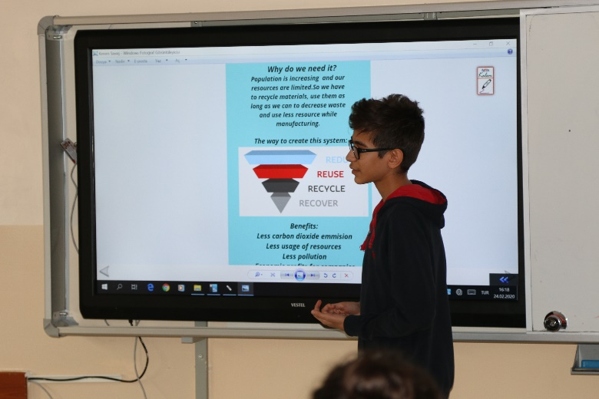
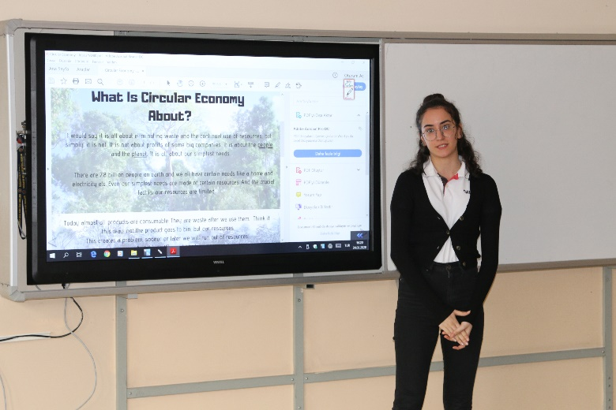
Students’ Works & Presentations

Slide 8
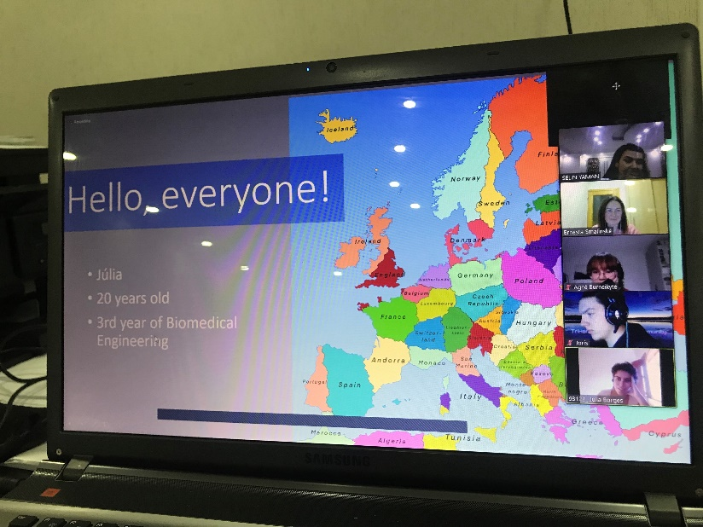
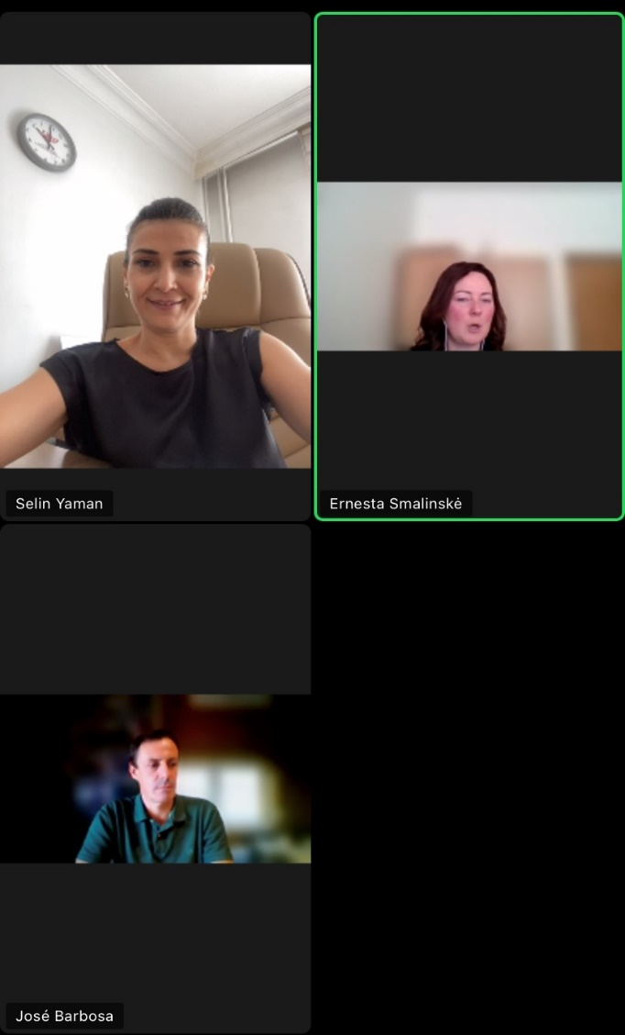
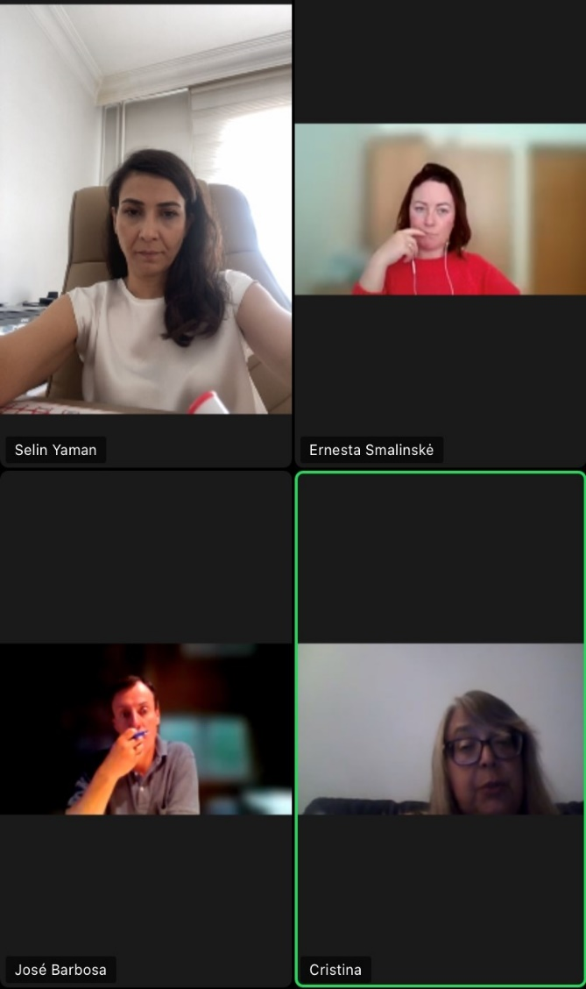
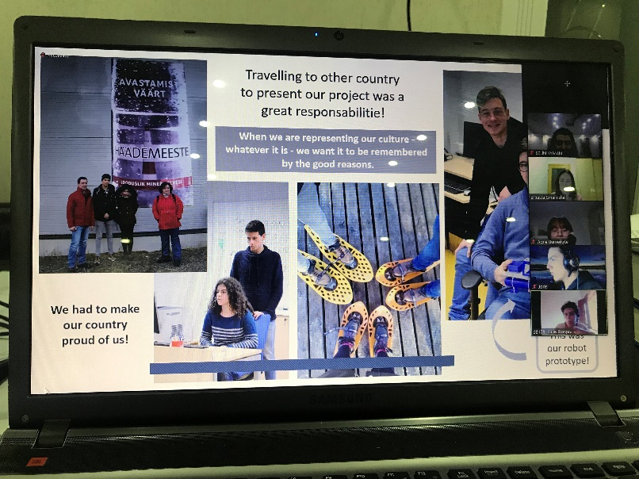
Meetings

Slide 9

VIDEOCONFERENCE
May, 2020

Slide 10

ERASMUSDAYS
October, 2020

Slide 11
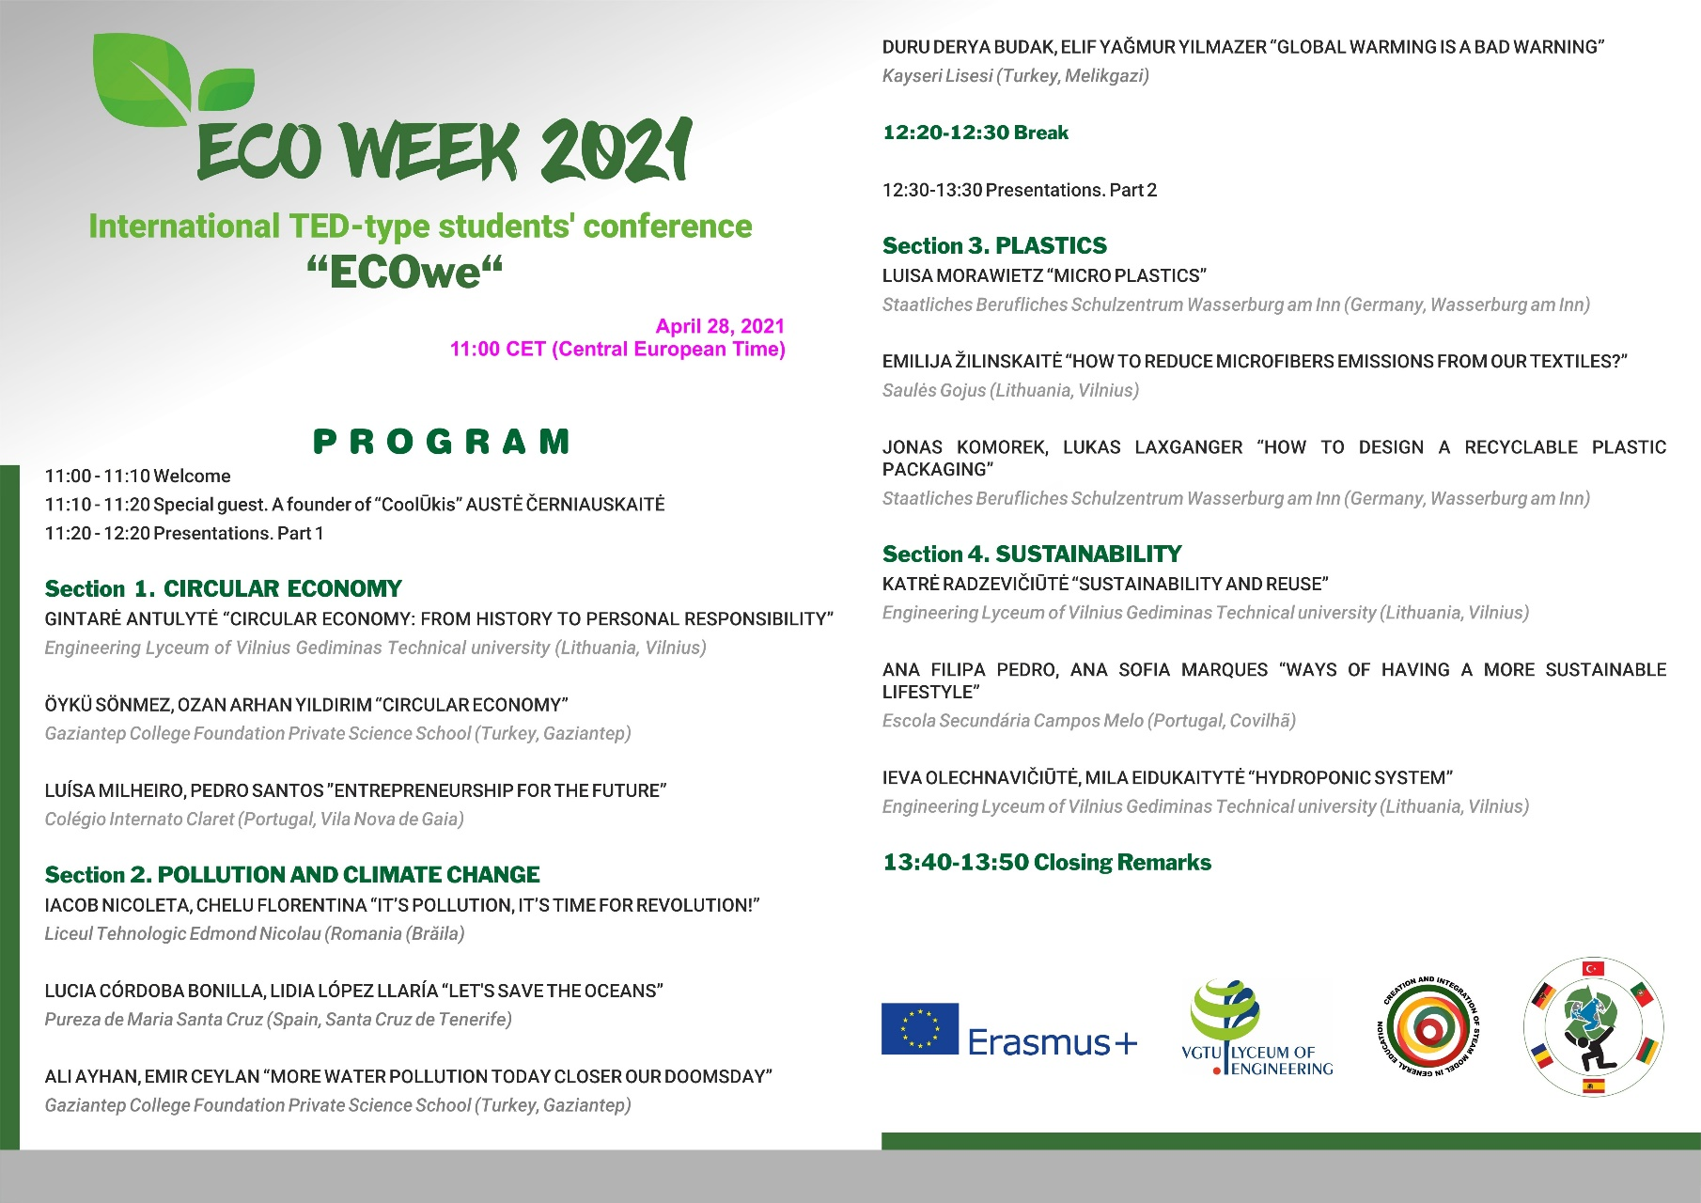
STUDENTS’
CONFERENCE
April, 2021

Slide 12
MOBILITIES PLANNED
November, 2021 PORTUGAL (LTT)
February, 2022 TÜRKİYE (LTT)
May, 2022 LITHUANIA ( Joint Staff Training)

Slide 13
ÖYKÜ SÖNMEZ
Student, GKV Erasmus+ Club

