Slide 1
ERASMUS+
.

Slide 2
WHAT IS ERASMUS+

Slide 3
THE OPPORTUNITIES OF ERASMUS+
.

Slide 4
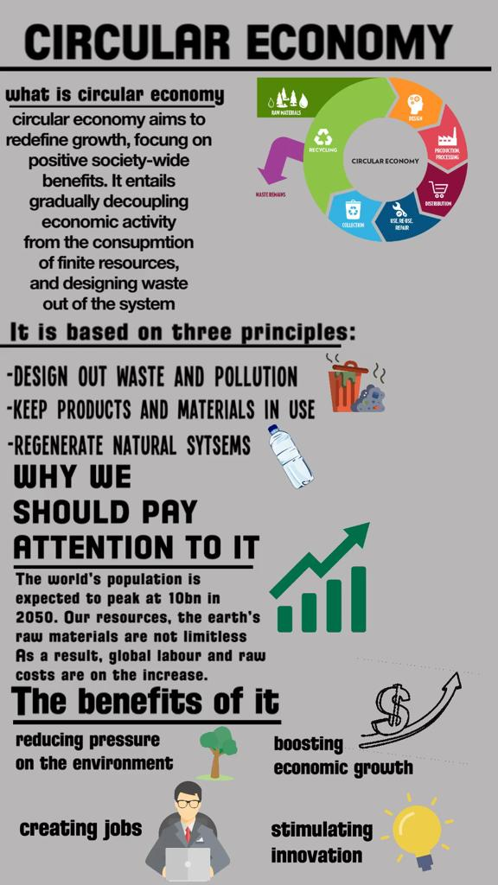
WHAT
DID WE DO?
- PRESENTATIONS:

Slide 5
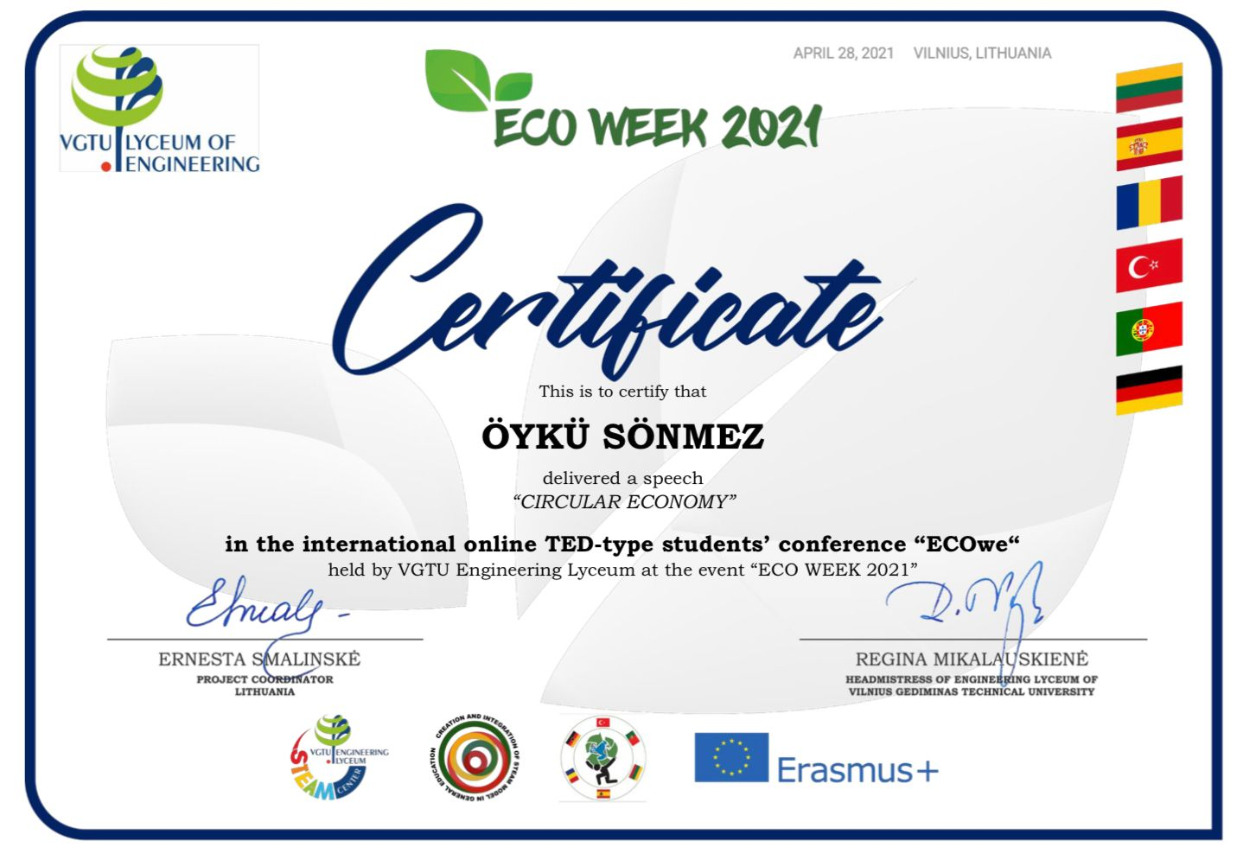
ECOWEEK’21
The certificate I got:

Slide 6
WHY IS ERASMUS+ IMPORTANT?
.

Slide 7
THANK YOU FOR LISTENING
.

