Slide 1
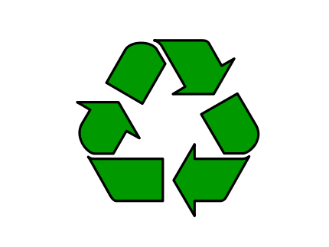
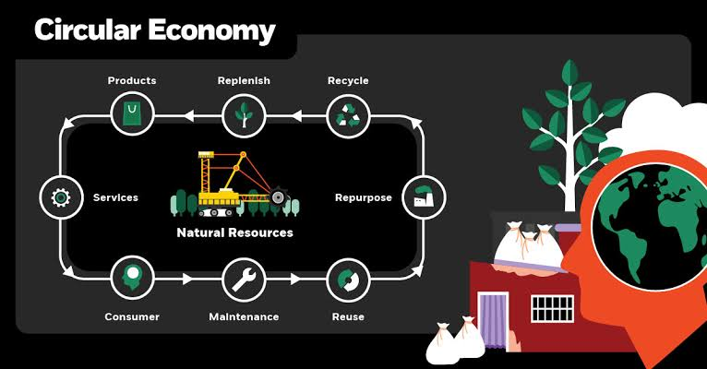
CIRCULAR ECONOMY

Slide 2
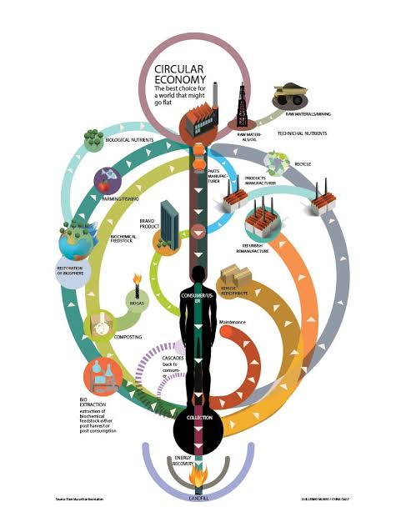
What is circular economy?
Circular economy is an industrial term, that refers to the transformation and recycling of industrial economics rather than the process of production, use and destruction. In a circular economy, manufacturers design reusable products, because the aim is to reuse the material.
Reduce (minimum use of raw materials)
Reuse (maximum reuse of products and components)
Recycle (high quality reuse of raw materials)

Slide 3
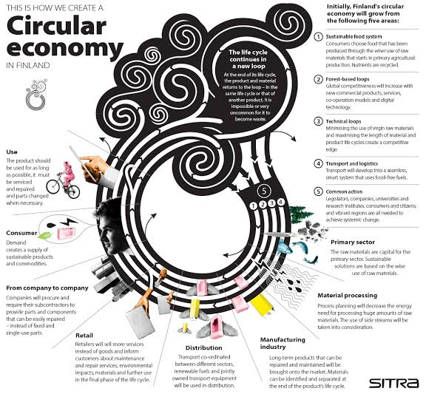
Why is circular economy important?
The world population is growing steadily, and this naturally directly affects the environment, so by 2050 we have to switch from a linear economy to a cyclical economy to provide enough food, water and requirements to the world's population. Our goal is to ensure healthy, safe living conditions and less environmental is to harm.

Slide 4
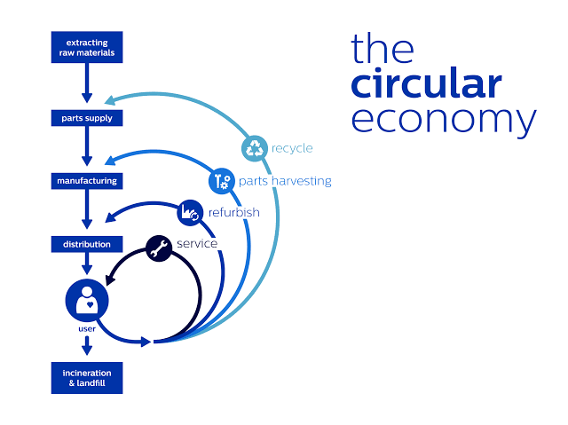
How do we apply circular economy?
Circular economy is an economic model against the system, which is based on a disposable system, and the products based on ready-made production are shelved to be used again after using them at once.
Therefore, the wastes that will be used in the circular economy, the works that can be done in this field, the necessary budget, the people who can work in this field and the environments where the work done should be determined well.

Slide 5
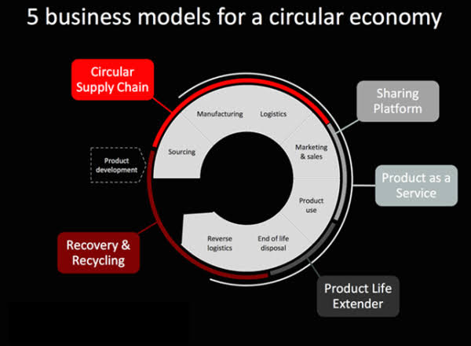
Circular economy business models:
Cyclical Supply Chain: Companies that supply fully renewable, recyclable or biodegradable materials are not affected by rising primary raw material prices, gaining competitive advantage.
Recycling and Recycling: Production and consumption systems are created in which every material previously considered to be waste is brought back to life for different uses.
Extending Product Life: With repairs, enhancements, remanufacturing or remarketing; economic benefits are provided for as long as possible from broken, spoiled, outdated products.
Sharing Platform: All idle, unused large or small items are rented and exchanged with sharing platform models; new relationships and business opportunities are emerging.
Product as a Service: Consumers pay for products based on usage; that is, it is hiring and a radical change in the business model is provided.

Slide 6
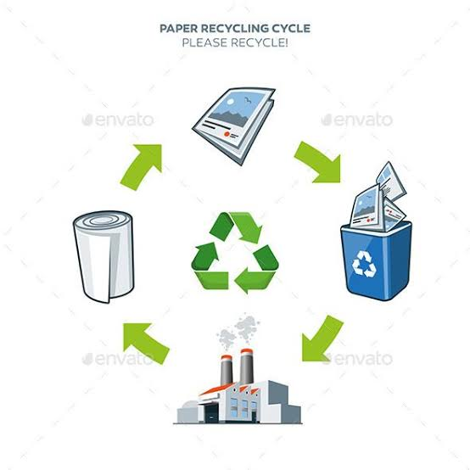
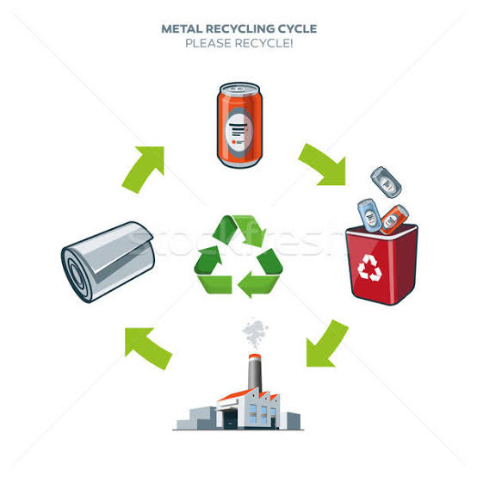
Waste and recyling:
Paper
Paper recycling uses mechanical processes to chew up paper into individual fibers, creating a pulp that can be made into new paper. Products made from recycled paper can come completely from recycled sources or contain a mixture of new and recycled paper. Unlike many other products, paper cannot be recycled indefinitely. The recycling process breaks the fibers, eventually making a product suitable only for lower-quality papers, such as newsprint.
Metal
Ninety-nine percent of beer cans and 97 percent of soda cans in the United States are made from aluminum.However, more steel - used primarily for food storage containers, construction materials and automobile parts - ends up in the waste stream. Aluminum and steel are both sorted during the recycling process and melted down to produce new items, such as new beverage cans or automobile parts. Recycling metals saves the cost and environmental impact of mining virgin materials.

Slide 7
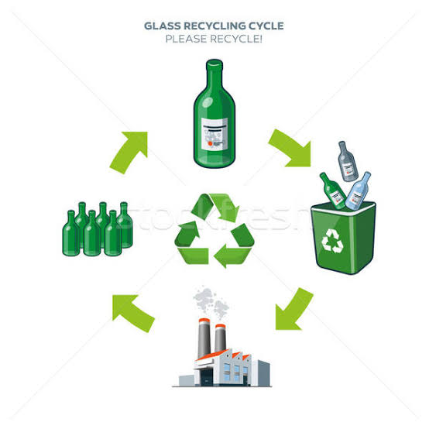
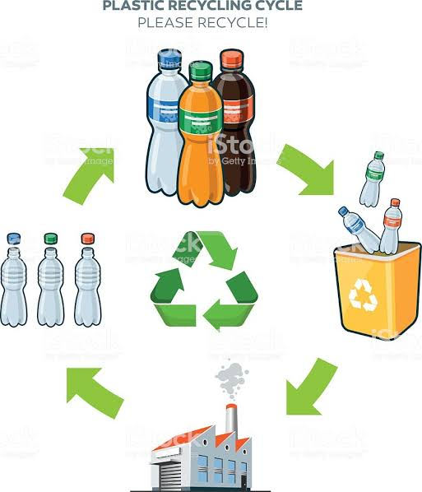
Glass
Recycling facilities crush glass and melt it down for use in new glass products. Since recycled glass melts at lower temperatures than new glass, it takes less energy and creates less pollution to make a product out of recycled glass. Most glass goes toward making beverage containers, but recycled glass has other applications, such as safety reflectors for roads.Although many curbside programs accept glass, in 2009 Americans only recycled about 31 percent of glass containers .
Plastics
Plastics make up more than just water bottles; they also form durable goods like appliances and medical devices, and nondurable goods like bags and diapers. U.S. use of plastics has risen in recent decades, and recycling plastics helps offsets the negative impacts of high use. Recycled plastics are ground into flakes that go into making new plastic products. You can identify the type of plastic and its recyclability by checking the numeric code that appears within a triangle on the container. Municipalities don't always recycle all types of plastic, so check with your local sanitation department before tossing all plastics into the recycling bin.

Slide 8
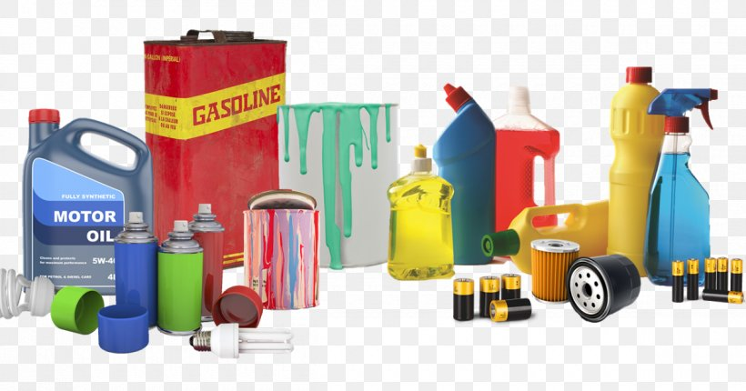
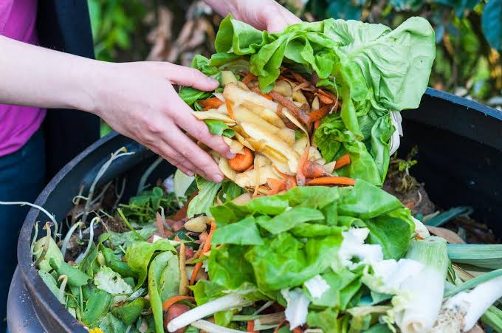
Hazardous wastes
Hazardous wastes contain corrosive, toxic, ignitable or reactive ingredients and can threaten the safety of people and the environment if improperly handled. Common household hazardous wastes include motor oil, pesticides, batteries and paints.
Organic Wastes
Organic wastes -- including yard trimmings, paper and food scraps -- made up over half of the solid waste stream in 2009.Depending on its original form, organic waste can be recycled into mulches and composts for gardening uses, or even be reborn as biodegradable products, paperboard, wood packaging, fiberboard and particle board.

Slide 9
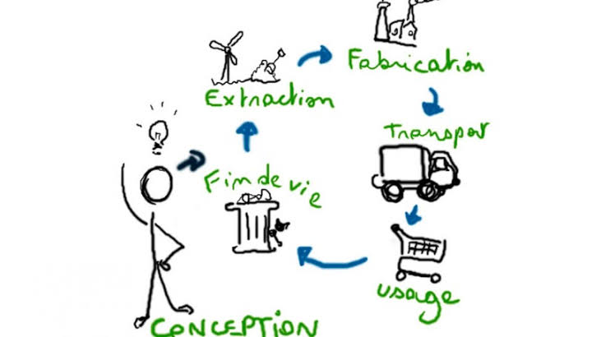
The huge amount of waste produced by the linear model is globally over 11 billion tons annually. Only 25% of this waste is recycled and returned to the reproduction system. If we do not make any significant changes in the current growth model, it is expected that an increase of more than 75% of urban waste and 35% of industrial waste between 2013 and 2025. While the Economic Cooperation and Development Organization (OECD) countries produce 4.6 billion tons of waste each year, this figure is 2.2 billion in Asia Pacific countries. 700 million industrial waste, 300 million urban waste, of the annual loss of waste, reaching a total of 1 trillion.
Is Recycling Enough to Solve This Problem? No. It only lightens the load. Instead of recycling, it is more economically plausible to prevent waste from occurring primarily by renewing and reusing products and components.

Slide 10
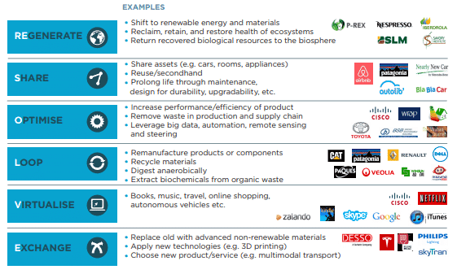
We are currently consuming 50% more resources than the amount of pollution that the earth can reproduce and absorb. This excessive resource consumption measurement is called "ecological footprint". The total area occupied by people to produce the resources they consume is defined as the places they use to build their buildings and roads and ecosystems that eliminate the effects of the waste they cause. These data are compared with the data of the biologically productive areas called «biocapacity
Responsibility of the Companies
People now hold companies as well as governments responsible for improving their quality of life. According to a study by the UN Global Impact and Accenture, which has 30,000 people on five continents, 72% of respondents believe their use is insufficient to meet expectations for social benefit.

Slide 11
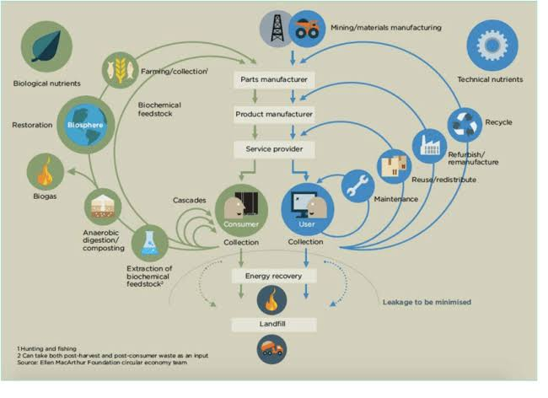
To support the adoption of circular economy principles, the Ellen McArthur Foundation, a non-profit organization funded by a leading group of global companies, was established. The foundation focused mainly on gathering different schools of thought around an integrated framework called "circular economy".

